Slide 1
Waimangu Geyser
The biggest Geyser in the world
New Zealand

Slide 2
«I'm an expert, I want people to accept my information!»
Target mindset
(as Tatyana Grigir’evna said at the previous lesson):

Slide 3
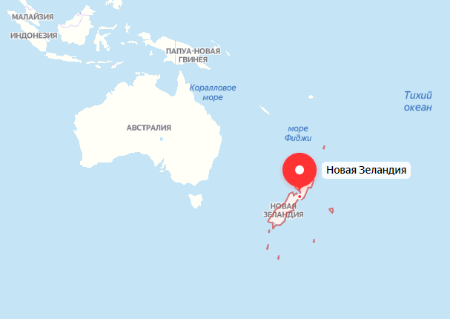
If we intend to find the biggest geyser in the world, we should definitely visit New Zealand

Slide 4
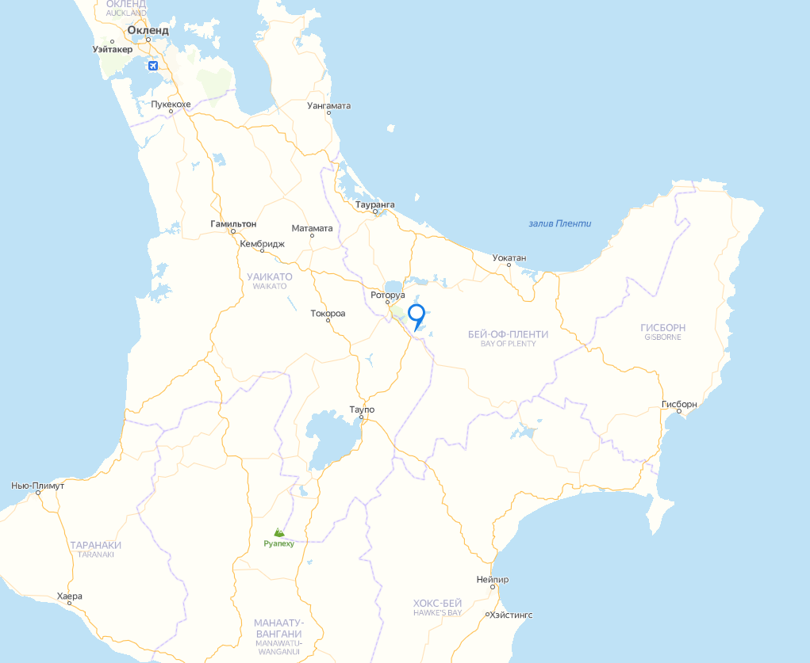
More specifically, that geyser is next to the «Bay of Plenty».

Slide 5
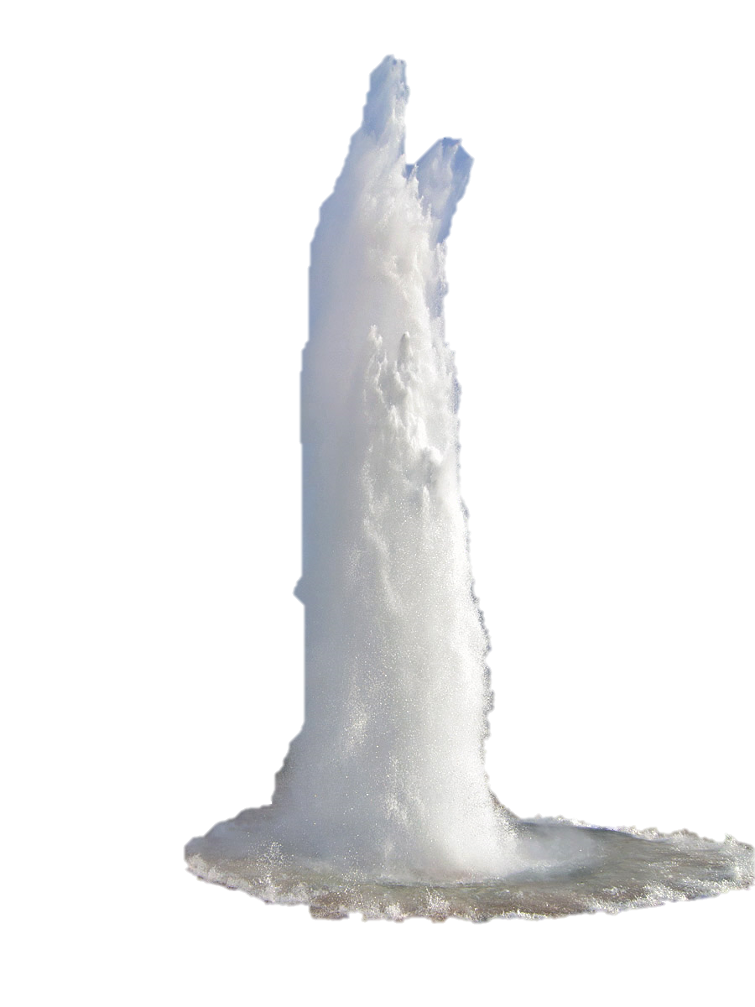
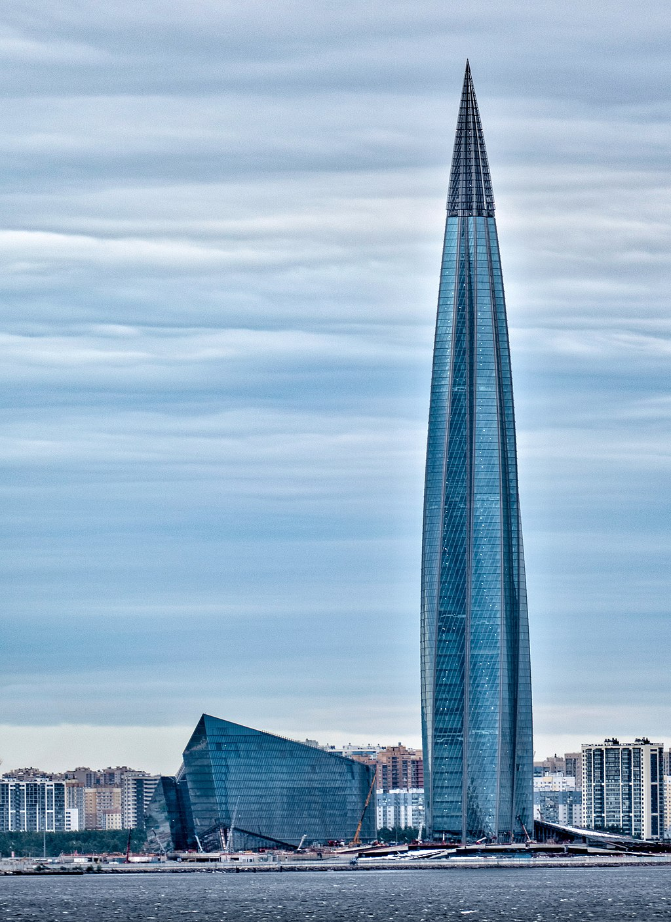
400 meters! It’s a water column with height of Lachta-Center!

Slide 6
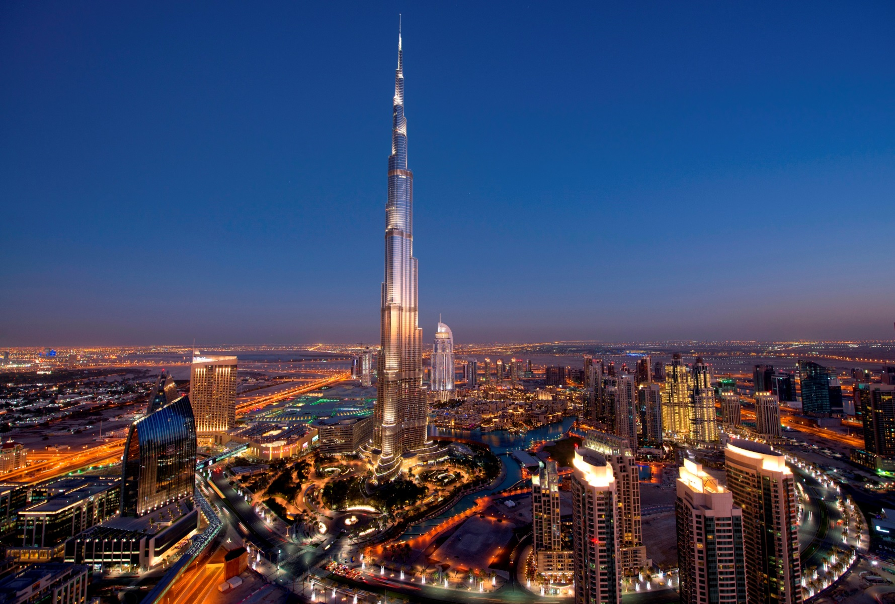
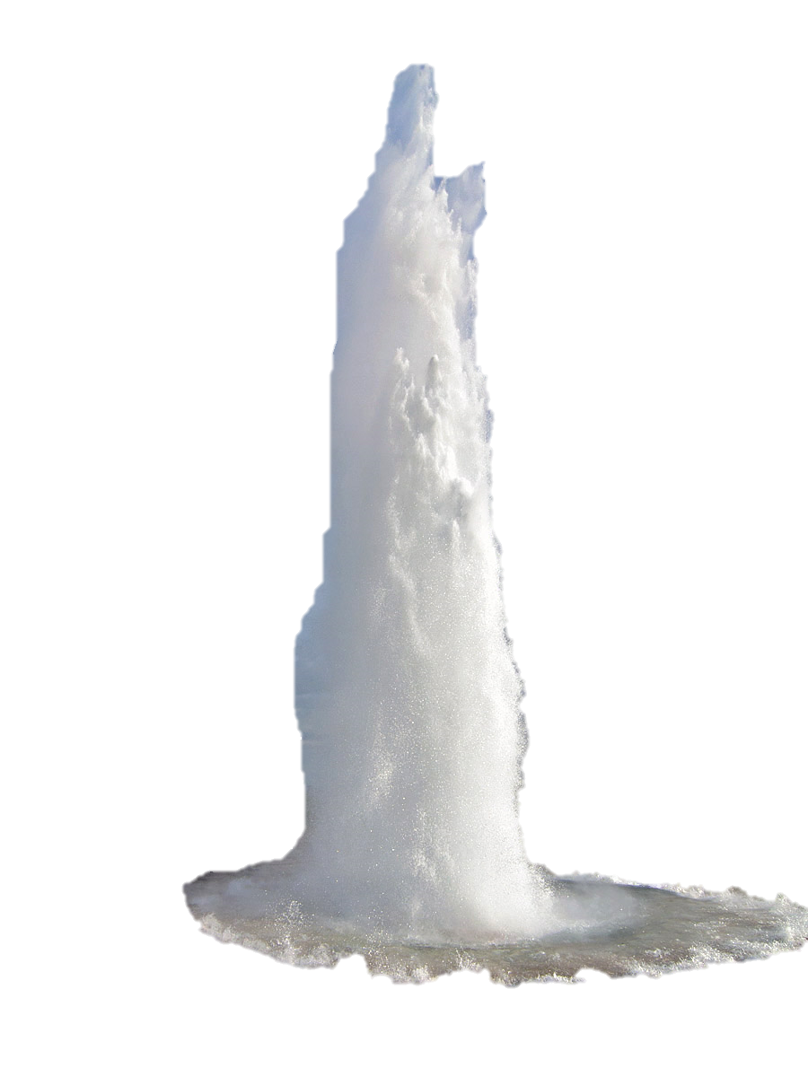
And it’s even comparable with Burj Khalifa — the highest construction people have ever built!

Slide 7
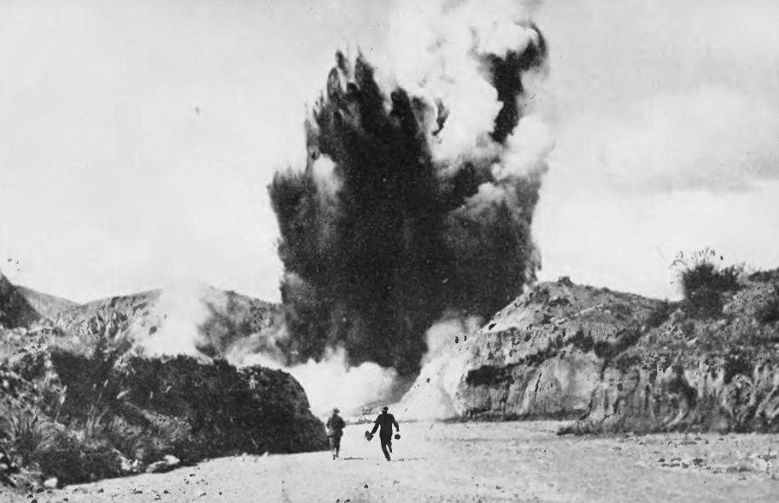
The geyser had been discovered in 1913 and Wikipedia says, that it was rather popular among aboriginals: the eruptions were quite impressive.

Slide 8
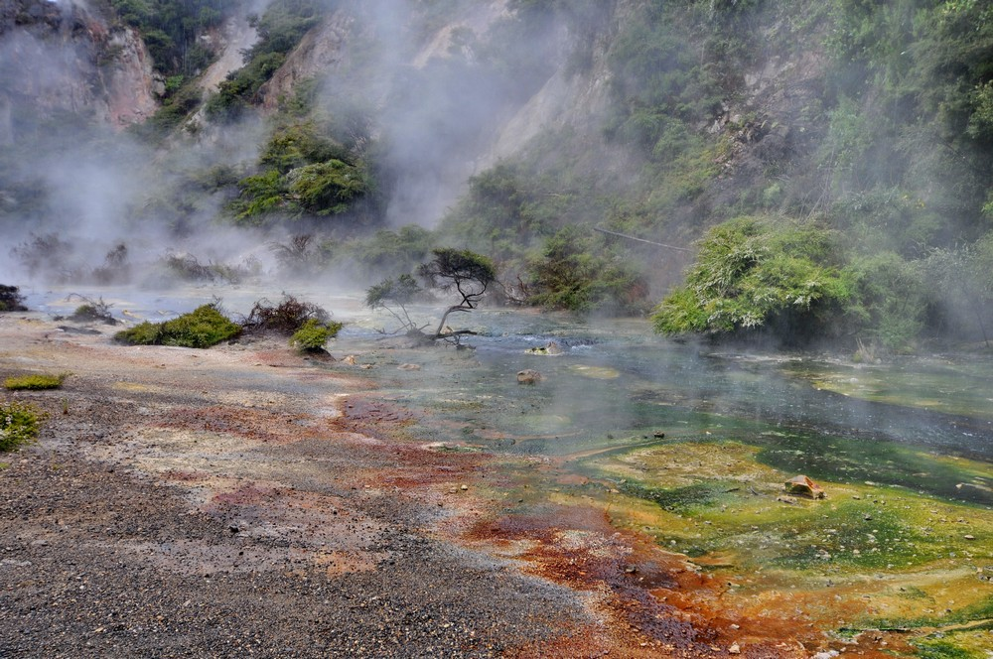
Obviously, it isn’t a lonely geyser. It’s surrounded by its «Siblings»: smaller geysers

Slide 9
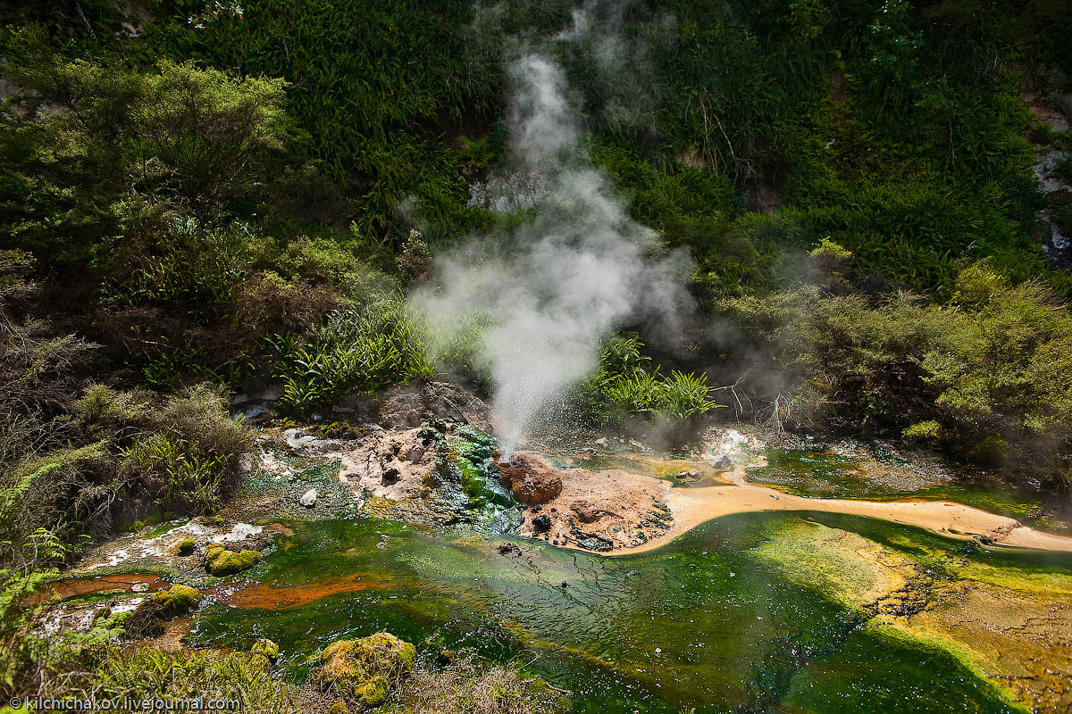
Here’s on of those geysers. It’s small but it shows promise. Little pigeons can carry great messages.

Slide 10
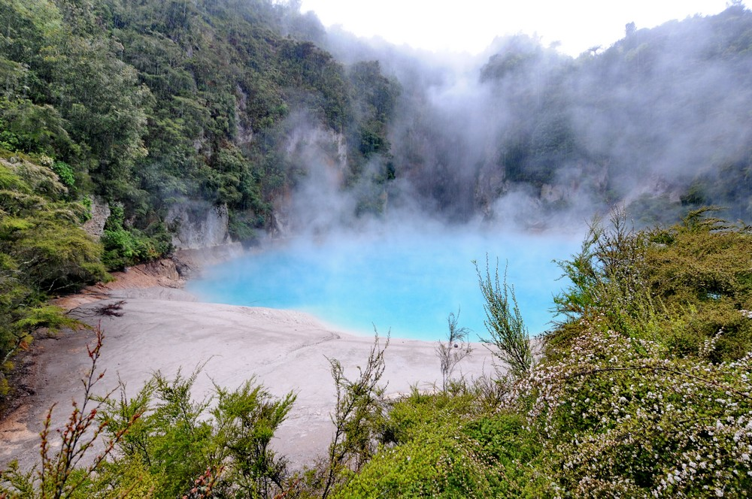
There is also an incredibly beautiful «Blue» lake next to the geyser.

Slide 11
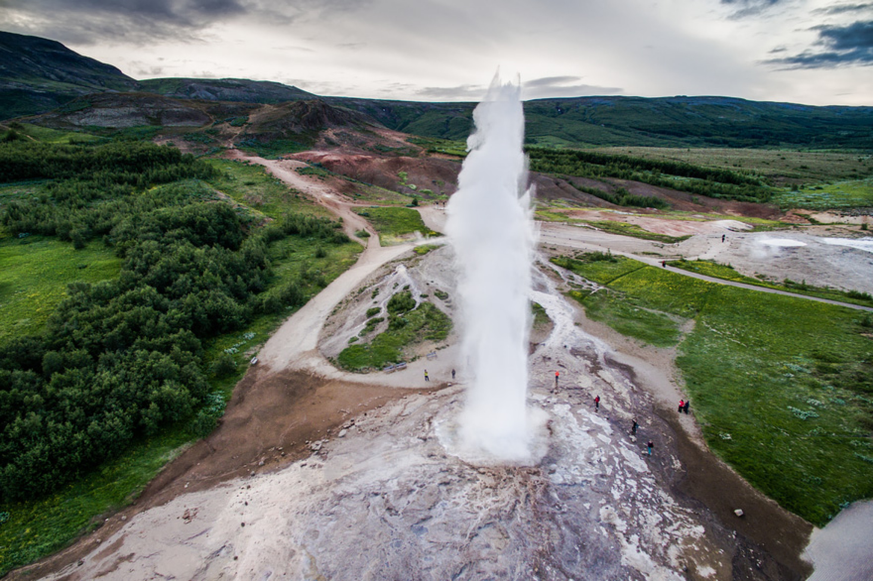
Sitting on a sofa, it’s pretty difficult to realize(,) how beautiful the eruptions are. But this picture can bring you closer to understanding:

Slide 12
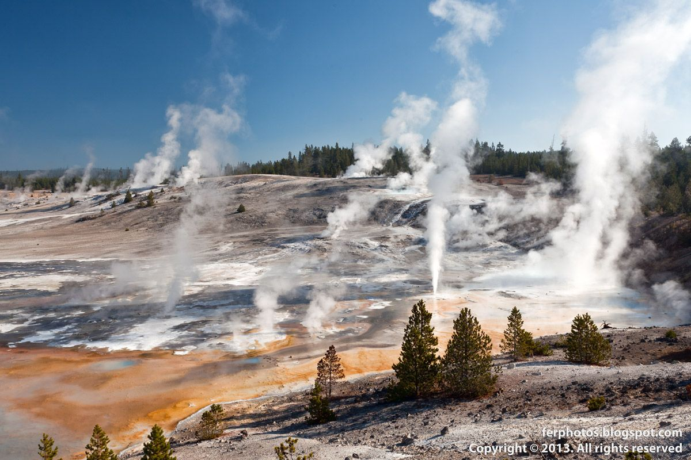
Thanks for your attention!

Slide 13
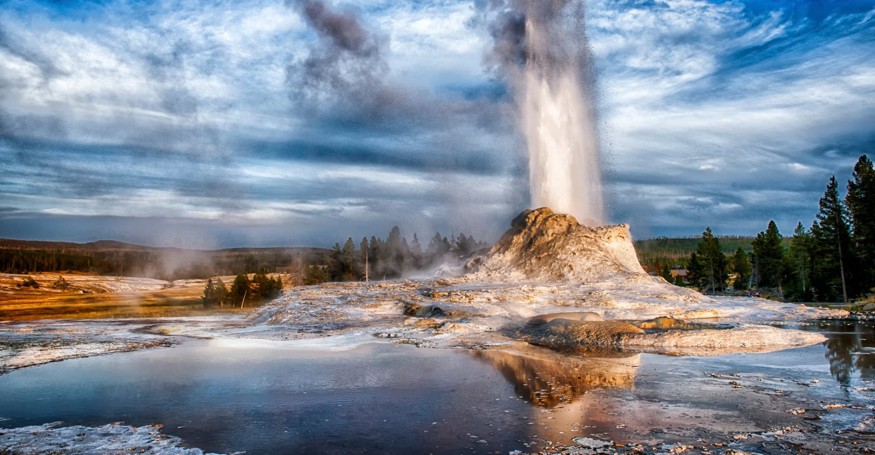
You are welcome to ask so many questions that they become uncountable and can be called «much questions»

